Slide 1
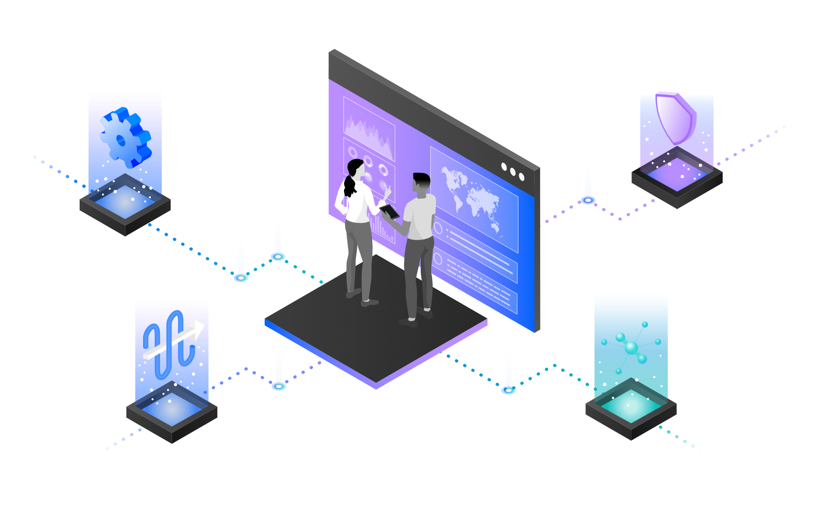
IBM App Connect
AI Powered Integration with IBM App Connect Designer
—
Brian Wilson Americas Principal Automation Technical Sales Leader
Rafael Osorio Senior, Learning Content Development, Automation Software
Notes:
Today we will demonstrate This demo will walk you how to use IBM App Connect Designer AI-powered tooling to simplify integration flow development, mapping and data transformation.

Slide 2

AI Powered Integration
Integration enables AI
Integration is a critical factor for the success of customers delivering AI projects
AI empowers Integration
Applying AI within Integration products enables users to achieve powerful and differentiating results
AI delivers benefits across the user spectrum – business, developers, and operations
Enhances user effectiveness as AI performs manual or time-consuming work
AI supports and enhances human-led innovation, without replacing the human
Notes:
In a world where disruption is the norm, businesses that harness AI will become industry leaders. On the other hand, we know that Integration is the key step of a successful Digital Transformation journey. But how are you leveraging AI to implement your Integration strategy? Are you creating Integration flows using AI Natural Language Processing capabilities? Are you using AI-powered mapping assistance and data transformation capabilities when designing integration flows?

Slide 3
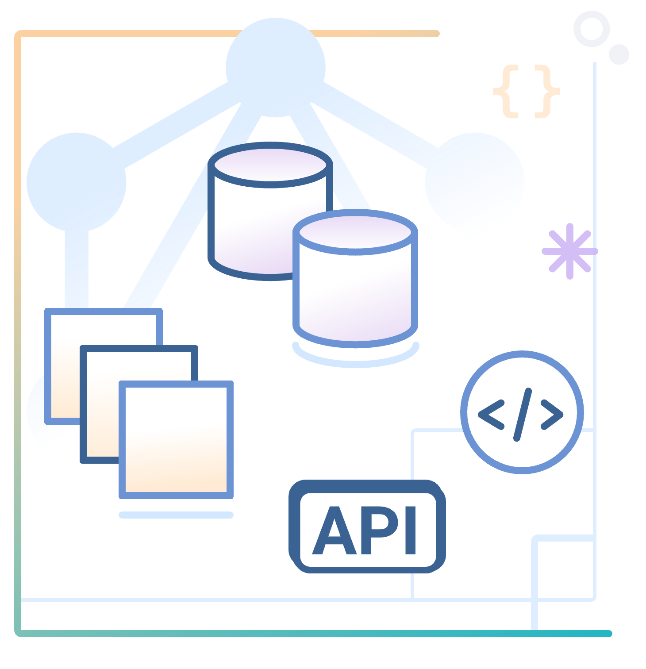
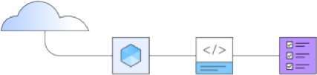
Focus Corporation Scenario
Hypothetical retail company that wants to derive more revenue from first-time customers to their online storefronts.
Focus has acquired another business and needs to synchronize the contacts between two CRM applications.
Data mapping is among the most important design steps in building an integration flow. This design-time task is usually the most tedious, time-consuming, complex, and error-prone because it requires deep understanding of all the data fields on the source and target systems.
Focus’ team would like to use AI-powered tooling to simplify integration flow development, mapping and data transformation.
Notes:
Focus Corporation, a hypothetical retail company engaged with IBM, is highly motivated to derive more revenue from first-time customers to their online storefronts.
Focus has acquired another business and needs to synchronize the contacts between two CRM applications. Data mapping is among the most important design steps in building an integration flow. This design-time task is usually the most tedious, time-consuming, complex, and error-prone because it requires deep understanding of all the data fields on the source and target systems. Building a successful data mapping also requires business analysis, domain expertise, and technical knowledge on both source and target systems.

Slide 4
Demonstration Agenda
09
9 - Test the API flow
08
8 – Implement the flow
07
7 - Create flows for an API
06
6 - Test your data sync
05
5 - Generate a Transformation
04
4 - Use the Mapping Assist feature
03
3 - Explore and improve the flow
02
2 - Create AI generated event-driven flow
1 - Access the App Connect environment
01
Notes:
In the demo we will execute the following steps:
Access the App Connect environment
Create AI generated event-driven flow
Explore and improve the flow
Use the Mapping Assist feature
Generate a Transformation
Test your data sync
Create flows for an API
Implement the flow
Test the API flow
Let’s get started!

Slide 5

Demonstration
Notes:
See script documentation for assistance in demo execution

Slide 6
Demonstration Summary
In this demo, the Focus’ team:
Created an AI generated flow to synchronize contact data between SalesForce CRM and Insightly CRM
Improved the Event-driven flow using IBM App Connect Designer
Used the Mapping Assist capability to implement data mapping between the different applications
Created data transformation function in minutes instead of hours with no code
Created a flow for an API from scratch using a no-code/low-code approach
They auto-mapped all the fields where the matching confidence was at least 80%. Mapping Assist learns from their decisions about selected mappings and shows these as top suggestions when a similar source and target mapping is attempted in the future -- further reducing their mapping efforts.
The Focus team also generated a data transformation by providing examples of source and target data when fields do not have the same format. AI was used to determine the pattern and generate the transformation.
Using AI-powered Mapping Assist reduced the development time and eliminated errors as Focus Corporation successfully integrated the new customer contacts from their business acquisition.
Notes:
Let’s summarize what Focus’ team has done today. In this demo they:
Created an AI generated flow to synchronize contact data between Salesforce CRM and Insightly CRM
Improved the Event-driven flow using IBM App Connect Designer
Used the Mapping Assist capability to implement data mapping between the different applications
Created data transformation function in minutes instead of hours with no code
Created a flow for an API from scratch using a no-code/low-code approach
As we mentioned in the beginning, data mapping is difficult, time-consuming, and error prone. In this demo, the Focus team learned how AI-powered Mapping Assist can alleviate these issues. They auto-mapped all the fields where the matching confidence was at least 80%. Mapping Assist learns from their decisions about selected mappings and shows these as top suggestions when a similar source and target mapping is attempted in the future -- further reducing their mapping efforts. The Focus team also generated a data transformation by providing examples of source and target data when fields do not have the same format. AI was used to determine the pattern and generate the transformation. Using AI-powered Mapping Assist reduced the development time and eliminated errors as Focus Corporation successfully integrated the new customer contacts from their business acquisition. Thank you for attending today’s presentation.

Slide 7
Thank you
© Copyright IBM Corporation 2024. All rights reserved. The information contained in these materials is provided for informational purposes only and is provided AS IS without warranty of any kind, express or implied. Any statement of direction represents IBM’s current intent, is subject to change or withdrawal, and represent only goals and objectives. IBM, the IBM logo, ibm.com and IBM Automation are trademarks of IBM Corp., registered in many jurisdictions worldwide. Red Hat® and OpenShift® are trademarks or registered trademarks of Red Hat, Inc. or its subsidiaries in the United States and other countries. Other product and service names might be trademarks of IBM or other companies. A current list of IBM trademarks is available at Copyright and trademark information.
7
Notes:
Thank you for attending today’s presentation.

Slide 8
8

Slide 9
Backup Slides

Slide 10


IBM Cloud Pak for Integration
Client & Partner Applications
Shared asset
repository
Unified governance framework
API management
Application integration
End-to-end security
Enterprise messaging
Event streaming
High speed data transfer
AI and machine learning
Robotic Process Automation
Natural language interactions
Process mining
Event detection
Machine learning
3rd Party integrations
Operational models
IBM Automation foundation
Robotic Process Automation
Natural language interactions
Process and task mining
Event detection
Machine learning
3rd Party integrations
Operational models
IBM Cloud
AWS
Microsoft Azure
Google Cloud
VMware
Private
IBM Z IBM LinuxOne IBM Power Systems
End points
IBM Integration / © 2021 IBM Corporation
10
Notes:
NOTE: Use this slide if you want to give a product overview and describe the capabilities presented in this demo.
IBM Cloud Pak for Integration is a hybrid integration platform with an automated, closed-loop approach that supports multiple styles of integration within a single, unified experience. This Demo demonstrates how Cloud Pak for Integration automates customer interactions using APIs and Integration. In this demo, you will see the API Management, Application Integration and End-to-end security capabilities in action.

